Slide 1

Marketing Web Analytics & Insights
MKT6352.001 – Group 5
Neha Sri Reddy Kotla
Racheal Sneha Anthony
Rana Udayveer Singh
Sai Rishta Vanumu
Vaishnavi Gawali
Yatin Kumar

Slide 2
Agenda
Company Introduction
Business Objective
Key Performance Indicators & Recommendations
Conversion Rate
Revenue
AOV
Visitor
Bounce Rate
Water Fall Model

Slide 3
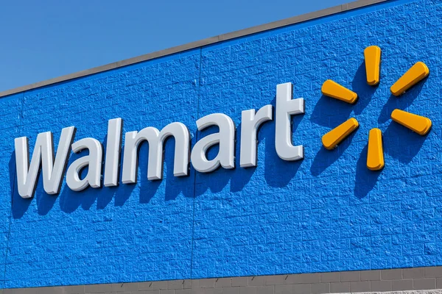
About Walmart
Walmart is a retail giant store – widespread in the USA with international presence
Founded in 1962 by Sam Walton in Rogers, Arkansas, USA.
Tagline “Save Money. Live Better” expresses commitment of delivering products at affordable prices.
Every Day Low Price (EDLP) is the cornerstone of their strategy
A vast network of 4,756 stores across the United States.
Partnership with Apple, Levi Strauss & Co, Starbucks and many renowned brands. Also has multiple exclusive Walmart products.
2% of Walmart's profits goes back to the community

Slide 4

Business Objectives
Improve the percentage of website visitors who will make the purchase.
Boost the revenue generation using device categories and overall revenue in the states of the US.
Decrease the percentage of visitors who navigate away from the site after viewing only one page.
Increase the average amount spent by customers per transaction for successful upselling or cross-selling strategies.

Slide 5
Key Performance Indicators
Conversion Rate
Revenue
AOV
Bounce Rate

Slide 6
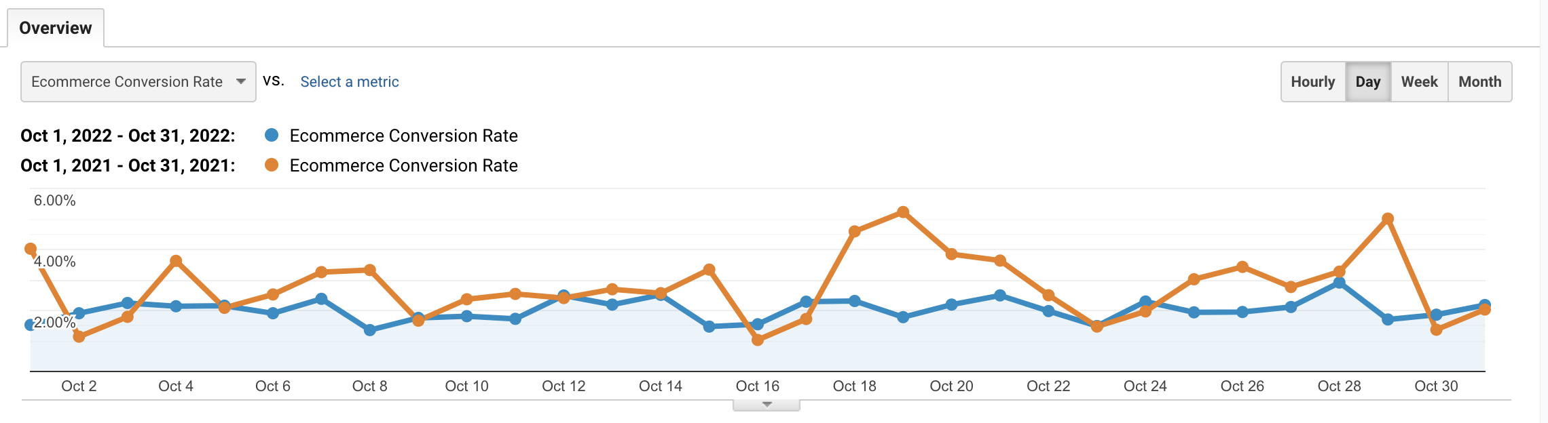
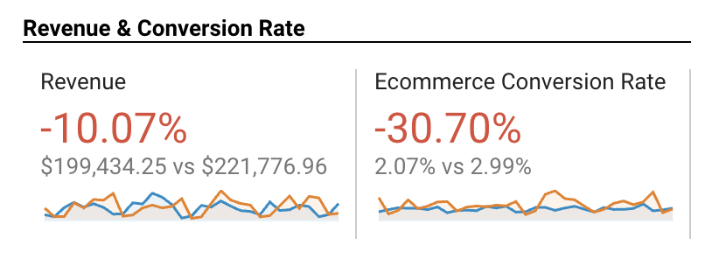
Conversion Rate
In October 2021, the conversion rate was 2.99% whereas in October 2022 it was 2.07%
There is a significant decrease in conversion rate by 30%

Slide 7
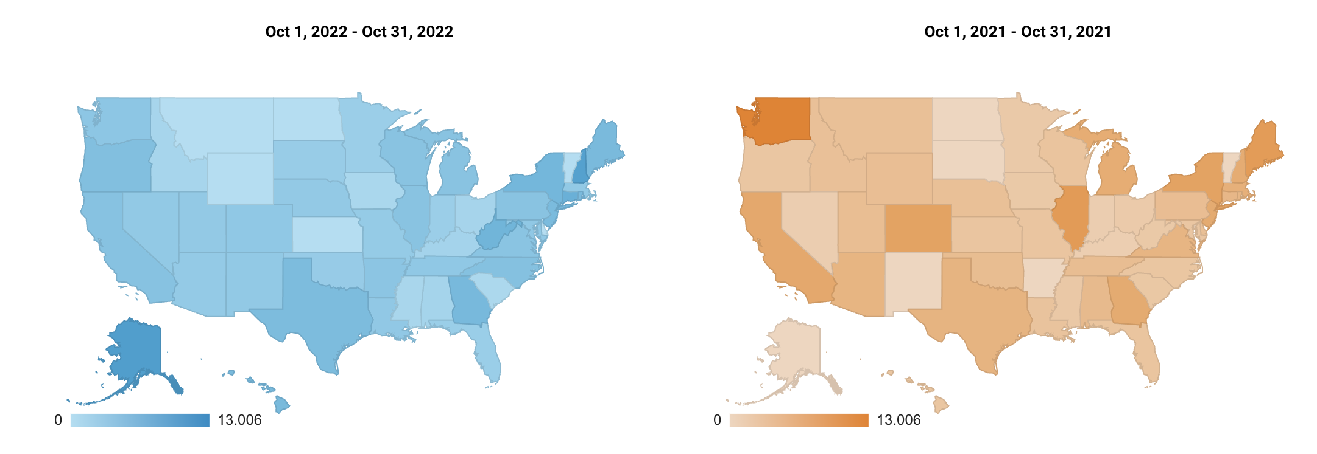
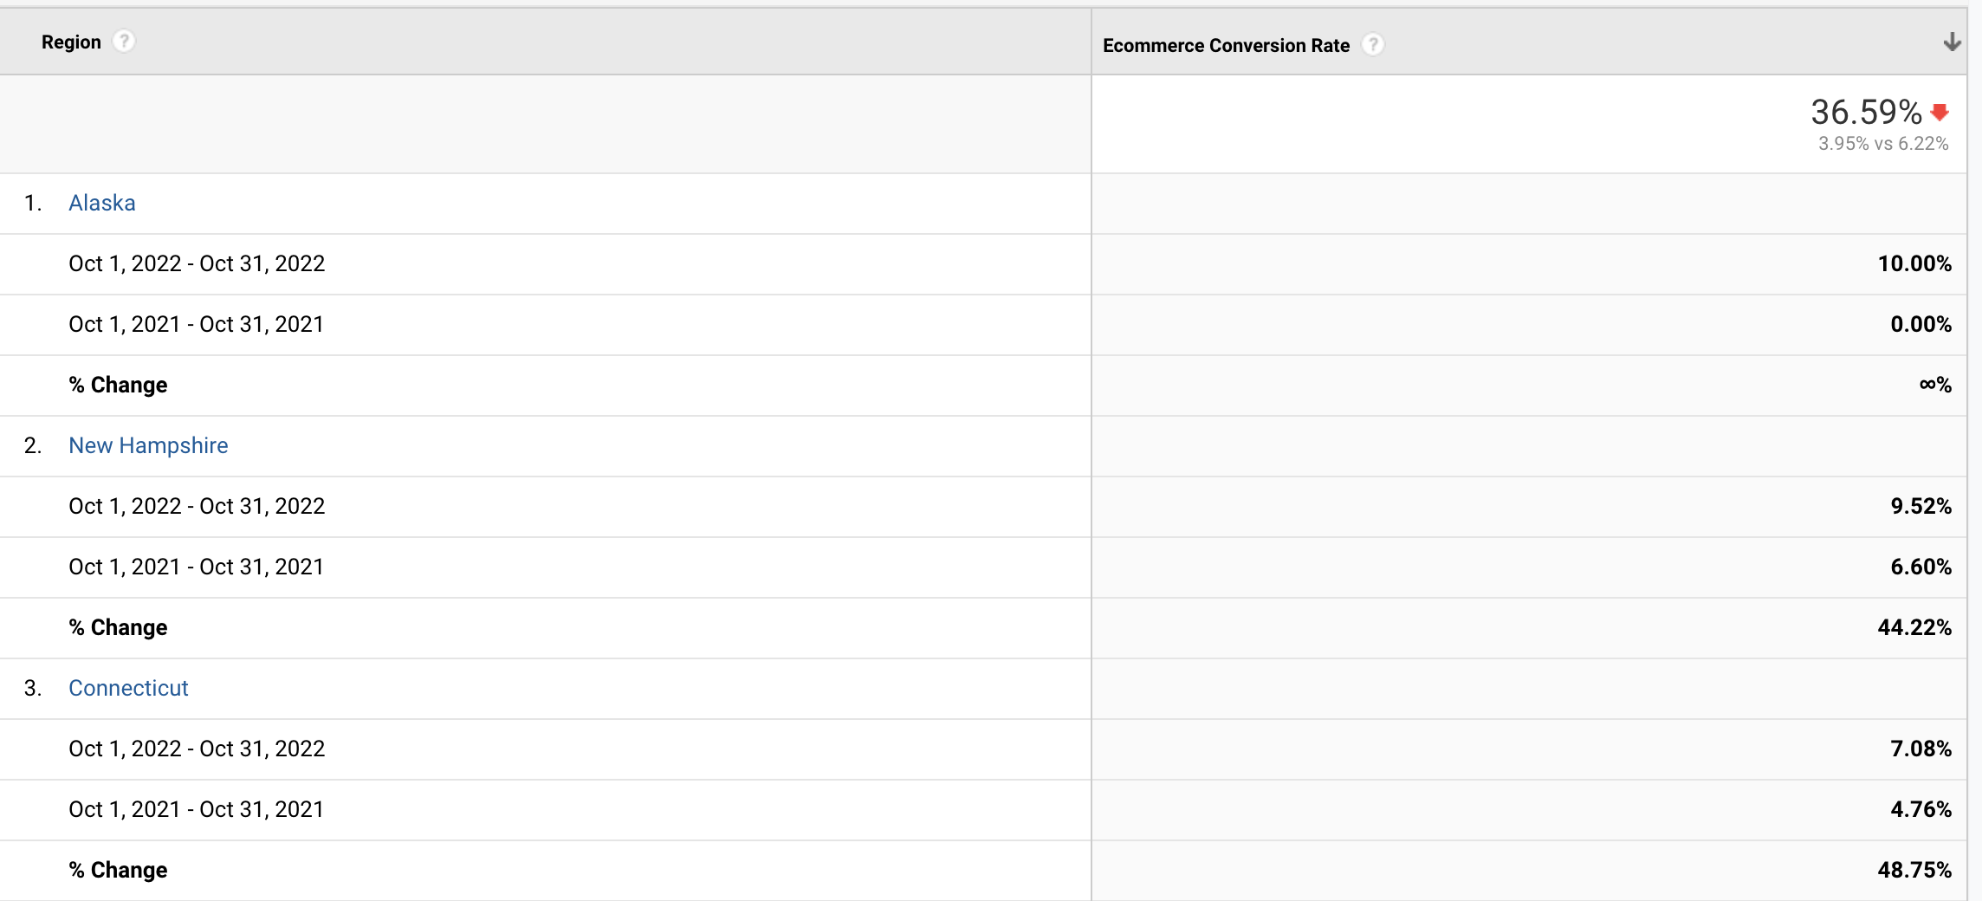
State-wise Conversion Rate
Alaska had the highest conversion rate in 2022.

Slide 8

Recommendations
Improve User Friendliness
User should not have to go through hassle to place order. Website/app should not have multiple steps to checkout.
Add clear product description and images
Provide detailed description and high-quality images for customer make informed decisions .
Assessing the effectiveness of campaigns
Walmart should monitor CTR and analyze how are the ad campaigns working and do retargeted campaigns.

Slide 9
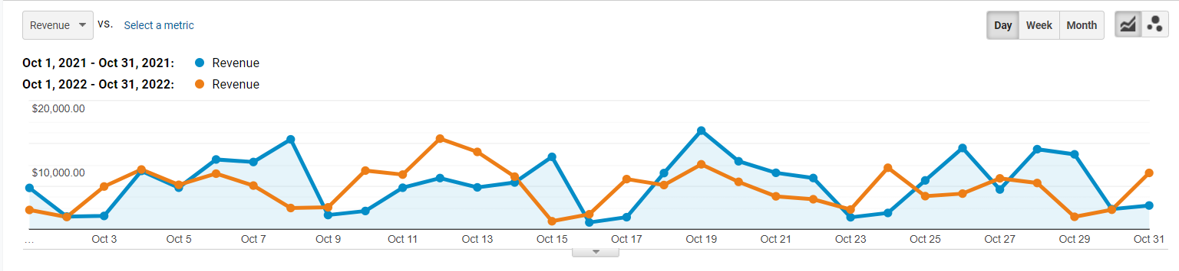
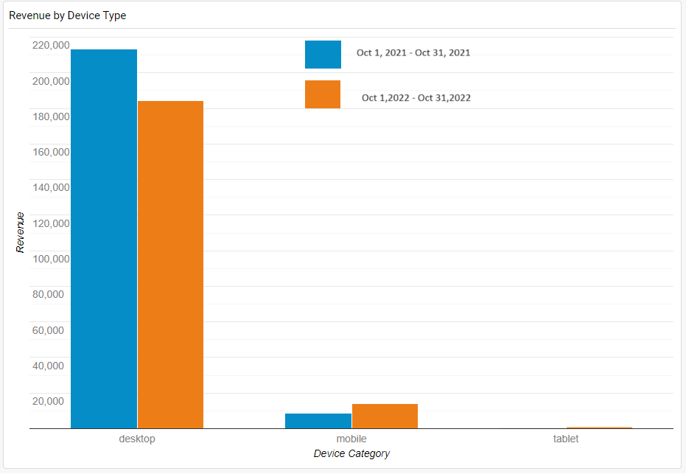
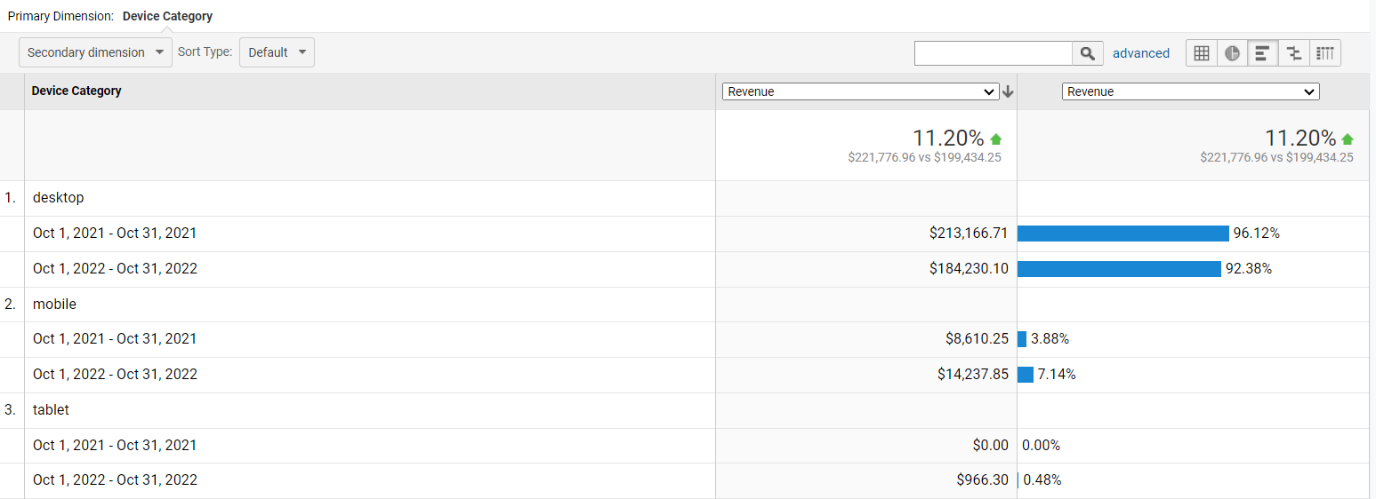
Revenue by Device Category
Overall revenue in Oct 2021 was 11.9% more than that was in Oct 2022
Maximum revenue was generated for Device Type Desktop followed by Mobile. Very less revenue was generated by Tablet

Slide 10
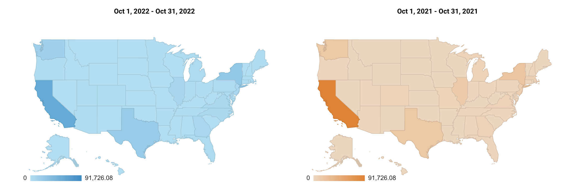
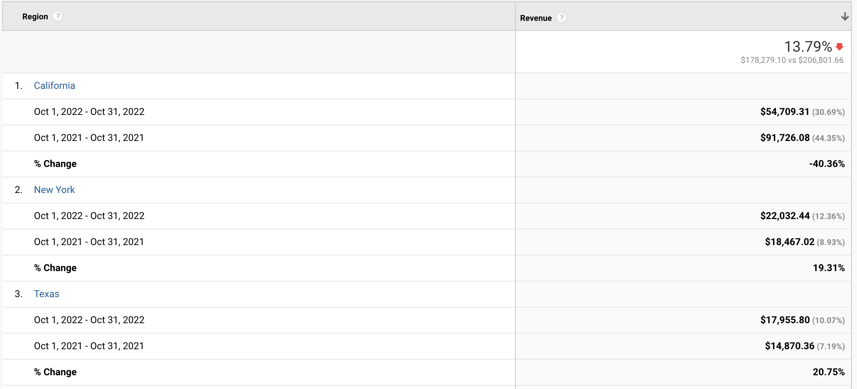
State-wise Revenue
The revenue segregated by states report shows that California was the state having highest revenue followed by New York

Slide 11
Recommendations
Improve user experience for Tablet and Mobile Devices
Walmart should increase investments in enhancing the user experience for tablets and mobile through website optimization, improved page load speed, and the implementation of push notifications to effectively engage mobile users.
Focus on marketing
Walmart should leverage in email marketing, social media promotion, and targeted discounts in specific Zip codes to boost revenue in states.
Customer Feedback and Adaptation
Walmart can collect feedback from targeted states and then use it to provide better products and services which would eventually help improve the revenue.

Slide 12
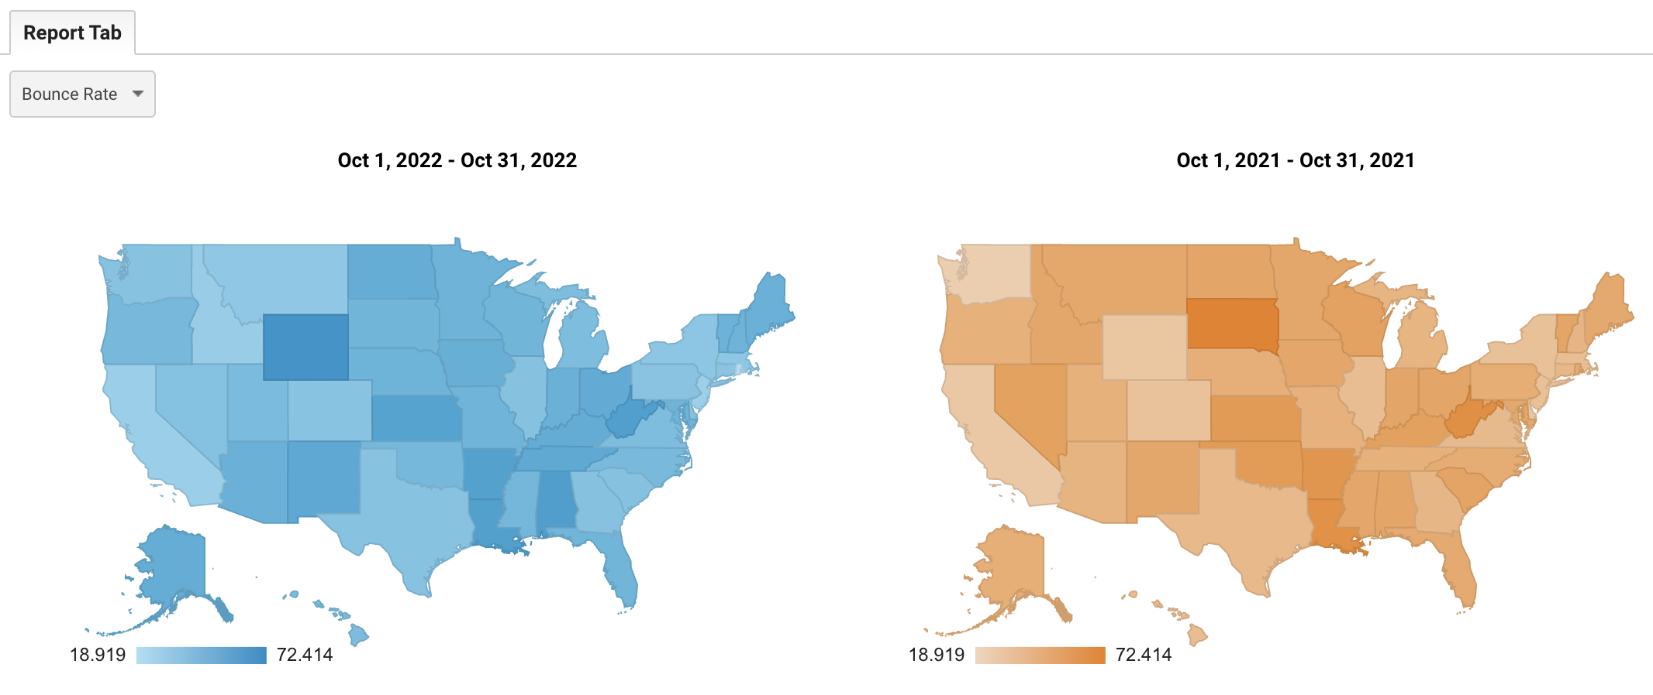
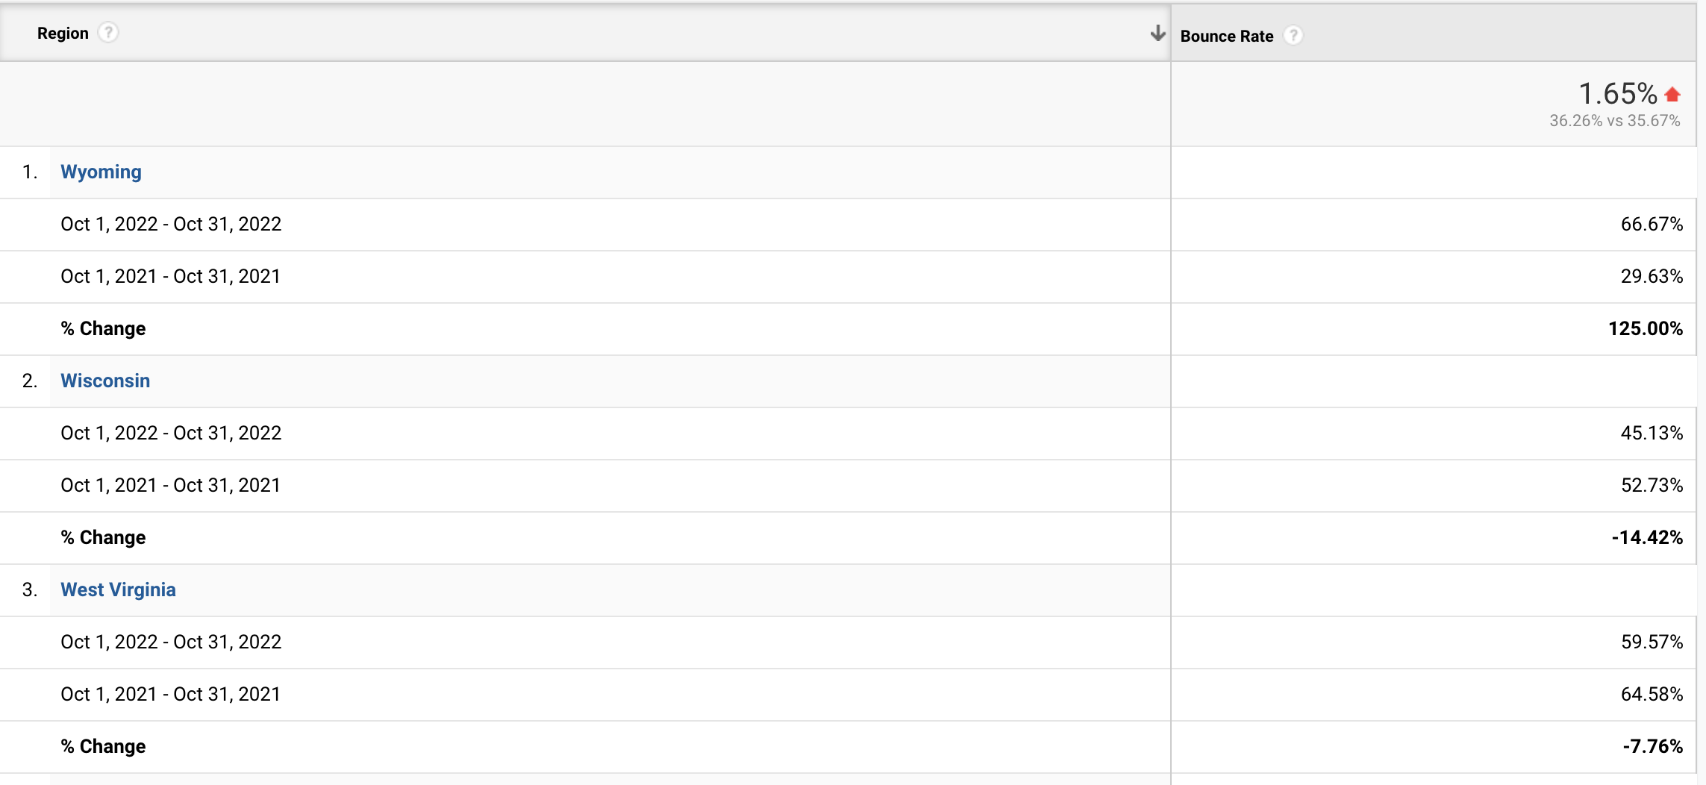
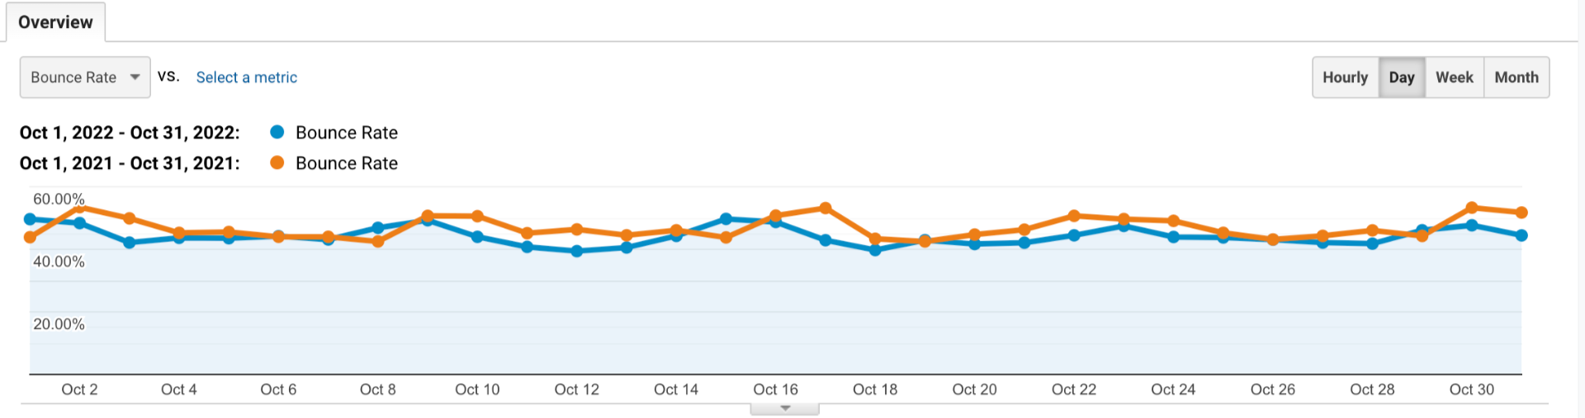
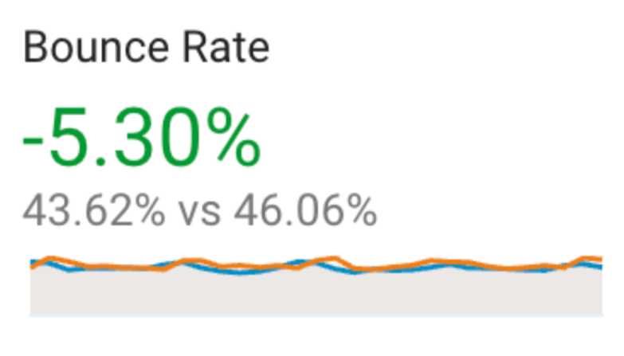
State-wise Bounce Rate
Bounce Rate decreased by 5.3% in Oct 2022.
Wyoming has the highest Bounce Rate followed by Wisconsin.

Slide 13
Recommendations
Minimize Pop-ups
Limit the use of pop-ups and if needed to be used, they should be timed properly or can be perceived as annoyance.
Optimize page load time
Page load time should not be high. This can be achieved by optimizing images, browser caching. A slow website can lead to increase in bounce rate.
Responsive Customer Chat
Offer customer services such as Live Chat or resolve query over call. Quick assistance can address visitor concern and prevent the exits.

Slide 14
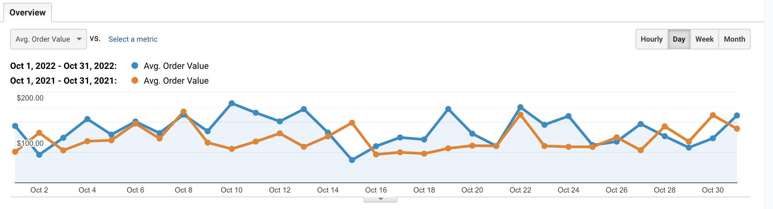
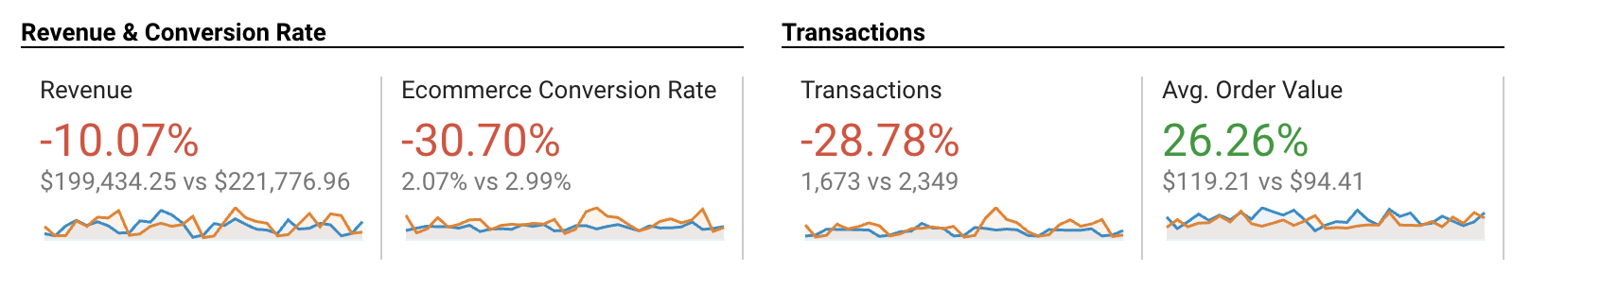
Average Order Value (AOV)
Average Order Value increased by 26.26% in Oct 2022.

Slide 15
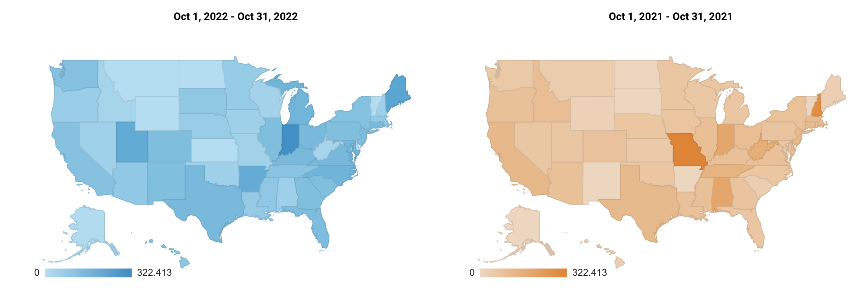
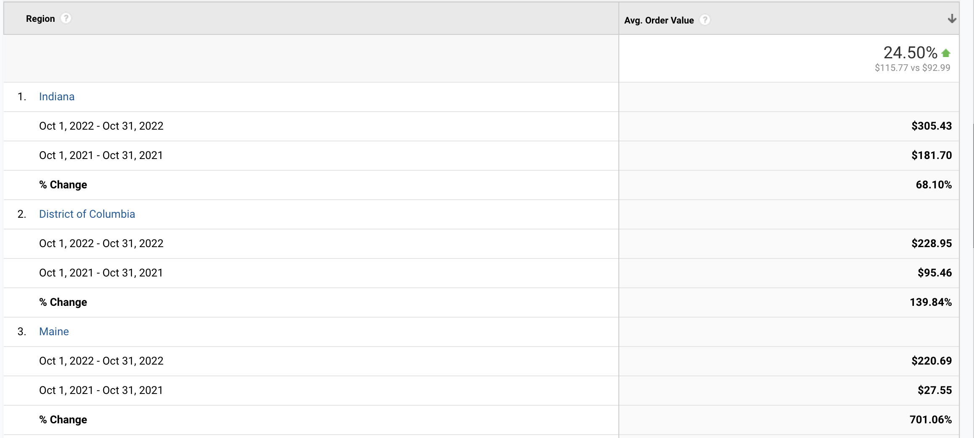
State-wise Average Order Value
Indiana has the highest Average Order Value followed by District of Columbia

Slide 16
Recommendations
Limited Time Promotions
Walmart should introduce limited time promotion such as 'Buy 2 Get 2 Free', 'Additional 25% off above particular total'. Offers like these will incentivize customer thus help to increase Average order value
Loyalty Programs
Provide customers with Rewards after spending a particular amount. Offer discounts and combo offers for loyal customers.
Post Purchase Upsell
Send emails or push notifications to customers after order is placed about upsell or add-ons which would encourage customer to make additional purchase

Slide 17
Water Fall Model
 | October 2022 | October 2021 | % Change vs LY | # Change vs LY | Impact on Revenue
Revenue | $ 199,434.25 | $ 221,776.96 | -10.07% | $ (22,342.71)
Visits | 80628 | 78449 | 2.78% | 2179 | $ 6,151.01
AOV | 119.21 | 94.41 | 26.27% | $ 24.80 | $ 58,171.50
Conversion | 2.07% | 2.99% | -30.77% | -0.92% | $ (68,138.60)
 |  |  |  | SUM | $ (3,816.09)
Overall, there is an increase in AOV and Visits, conversion rate dropped in October 2022 yet the impact on revenue is negative and it is driven by the decline in Conversion rate.

Slide 18
Thank You!

